Slide 1


CODEX 2023 BATCH PROJECT SUBMISSION
TOPIC MNAME:- YOUTUBE AUDIO AND VIDEO DOWNLOADER.
BY:-KSHITIZ RANJAN
&
RITURAJ GUPTA

Slide 2
PROGRAM BASSED ON WHICH LANGUAGE AND WHAT HAPPEN IN THIS PROJECT
OUR THIS PROJECT IS BASED ON PYTHON ,IN OUR THIS PROJECT WE IMPORTED SOME FUNCTIONS LIKE import youtube_dl
import tkinter as tk
from tkinter import *
from tkinter import filedialog, messagebox
CONTD….

Slide 3
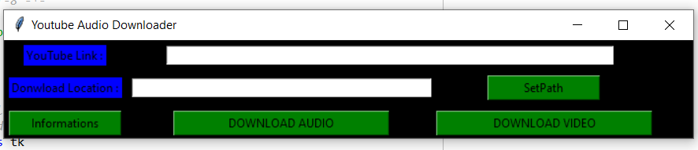
PROGRAM BASSED ON WHICH LANGUAGE AND WHAT HAPPEN IN THIS PROJECT
WHEN WE WILL RUN PROGRAM THEN A INTERFACE WILL OPEN WHERE WE WILL GET BUTTONS OF SELECT PATH FOR DOWNLOAD,INFORMATION,DOWNLOAD AUDIO AND DOWNLOAD VIDEO.

Slide 4
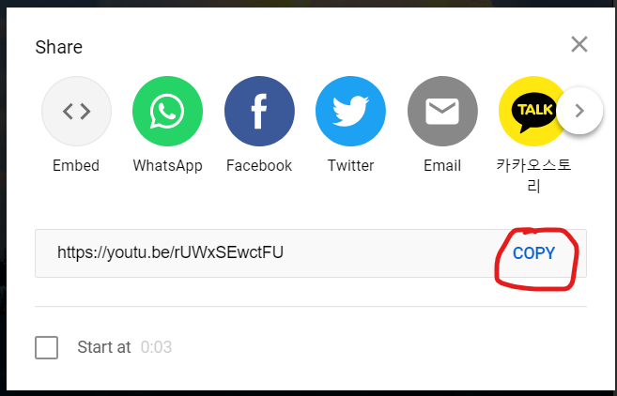
HOW THESE BUTTONS WILL WORK
FIRST OF VISIT AN Y BROWSER ,OPEN YOUTUBE AND COPY THE LINK OF VIDEO WHICH YOU WANTS TO DOWNLOAD.

Slide 5
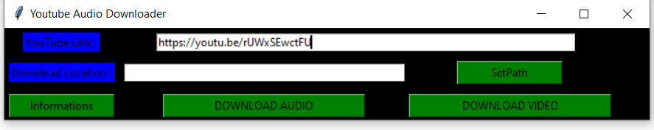
PASTE THE LINK IN YOUTUBE LINK OPTION
NOW PASTE THE LINK OF YOUTUBE VIDEOS IN YOUTUBE LINK OPTION WHICH YOU COPIED FROM YOUTUBE.

Slide 6
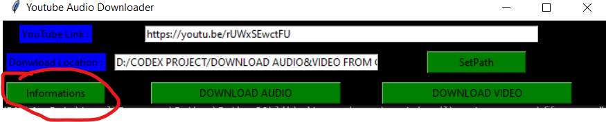
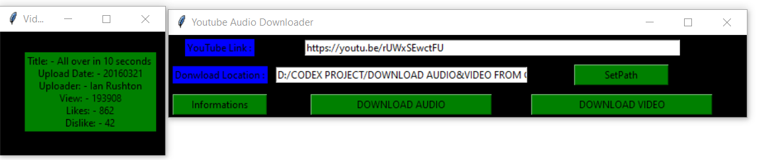
USE OF INFORMATION BUTTON
IF YOU WILL CLICK ON INFORMATION BUTTON AFTER PASTING LINK OF VIDEO,THEN IT WILL GIVES YOU INFORMATION OF TITLE OF VIDEO,UPLOAD DATE,VIEWS,LIKES AND DISLIKES.

Slide 7
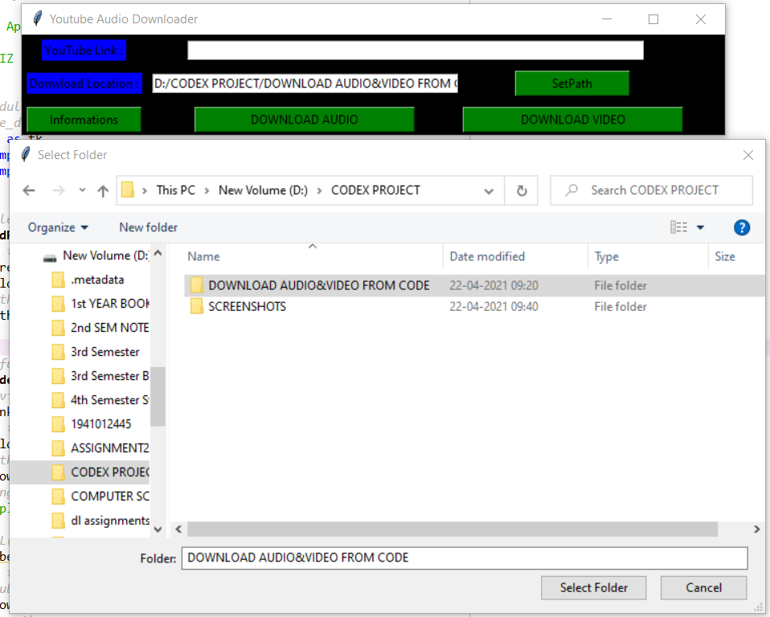
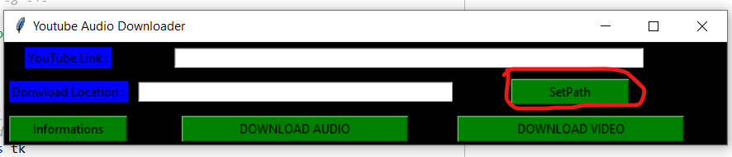
SET PATH BUTTON
CLICK ON SET PATH BUTTON TO SELECT THE LOCATION FOR DOWNLOADING AUDIO AND VIDEO.

Slide 8
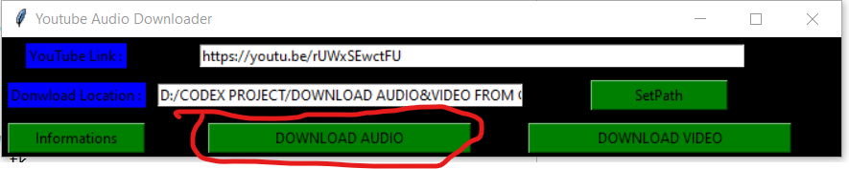
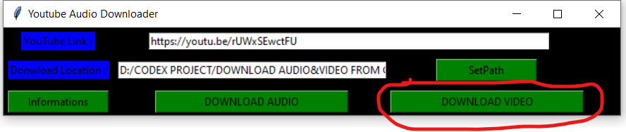
HOW TO DOWNLOAD AUDIO AND VIDEO
AFTER SETTING PATH ,AND COPYING YOUTUBE LINK WE CLICK ON DOWNLOAD YOUTUBE AUDIO AND DOWNLOAD VIDEO WE CAN DOWNLOAD AUDIO AND VIDEO.

Slide 9
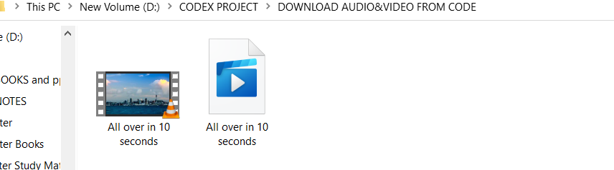
WHERE TO SEE DOWNLOADED AUDIO AND VIDEO
THE LOCATION THAT WE SELECTED FOR DOWNLOAD THERE WE WILL GET OUR DOWNLOADED AUDIO AND VIDEO.

Slide 10
TO INSTALL MODULE.
YouTube download
Module Required 'youtube_dl'
The module can be installed using the command - pip install youtube_dl
For Downloading the audio file you may counter with ERROR: ffprobe/avprobe and ffmpeg/avconv not found. Please install one.
To resolve this error download FFmpeg using choco install ffmpeg
The following file can also be converted to .exe using pyinstaller module
The module can be installed using the command - pip install pyinstaller
Then use the command pyinstaller Youtubedl.py
To get only the single use the command pyinstaller --onefile Youtubedl.py

Slide 11
PROJECT LINK:- https://github.com/codex-iter/YouTube_dl
THANKYOU

